Slide 1



WP4: Case Study Slovakia
Venice 11 October 2018
Sonila Danaj
European Centre for Social Welfare Policy and Research
danaj@euro.centre.org
POOSH
Occupational Safety and Health of Posted Workers:
Depicting the existing and future challenges in assuring decent working conditions and wellbeing of workers in hazardous sectors.

Slide 2
// Case and Method
// Slovakia ranked 6th in 2015 and 7th in 2016 as a sending country
// 2017: population 5.4 million, working age population 2.5 million, employment 66.2%,
150,000 working abroad
// Main sectors: manufacturing, wholesale and retail, transportation and storage
// Important sending country for posting, BUT receiving mostly temporary TCN workers: RS, BiH, UA
// 16 Interviews 06.2017-02.2018 with: Labour Inspectorate (2), Trade Union (2), Employer organisation (2),
Expert (2), Political advisor (1); Posted/Migrant workers (6), widow of posted worker (1)

Slide 3
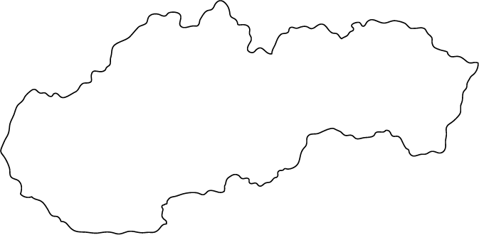
// Posting to and from Slovakia
Main countries of origin
Main destination countries
Germany, Austria, Czech Rep, Belgium,
France, Netherlands
Germany, Poland,
Czech Rep, Slovenia, Austria, France, Spain, Italy, Romania, Hungary
Main sectors
Main sectors
Industry, Construction, Commerce, Other services
Industry, Construction, Education, Other services

Slide 4
// Sectors
// Main findings I: OSH-related vulnerabilities
// High OSH risk for workers with irregular migration/employment status e.g. from 301 in 2016 to 1265 in 2017
// High OSH risk for workers hired via letterbox companies, e.g. Romanians posted via SK to BE
// Wages as a driver for temporary migration for TCNs confronted with social dumping lead to
neglect of OSH risks
// Subcontracting, often via agencies, as a way to reduce costs, even in terms of protective gear
// Poor working conditions and substandard accommodation
// Language barriers: small in everyday communication but significant when attempting to
understand national laws and regulations
// Social exclusion of migrant workers as a general concern
// Psychological strains of cross-border labour mobility and transient employment

Slide 5
// Sectors
// Main findings II: Institutional Framework
// OSH of PW is not receiving any attention in SK
// New Act on Posting (Act 351/2015)
// Labour Inspectorate:
Specific emphasis on illegal migration/employment and OSH, but
Perceived as a persecutory and punitive institution
// OSH- split between LI and Public Health Authorities and the respective
ministries creates tensions as cooperation has been difficult
// Trade Unions have had a limited role in OSH due to low union density, but
a distinction is made between unionized and non-unionized workplaces
// Active Associations: the OSH and fire protection association (Slovenská
asociácia pre bezpečnosť a ochranu zdravia pri práci a ochranu pred požiarmi)
// Agreement between LI and CTUs nationally, and IMI-system transnationally, bilateral agreements with non-EU countries

Slide 6
// Sectors
// Illustrative Example: sickness and death
The worker was posted from Slovakia to Austria via an Employment Agency
Got sick while posted
His health deteriorated and he returned to the hospital
The agency terminated him and cancelled his social security contributions (health care and social insurance), thus his care was no longer covered
The worker unfortunately died
With the legal support from an Austrian Trade Union, the widow makes a claim for care coverage and finally the company agrees to cover hospital costs.
The child care benefits in case of a diseased parent remain outstanding.
Pressured to return to work although not fully recovered otherwise he would be dismissed
// The main difficulty, as reported by the workers widow, is to get legal advice in cases of transnational grievances, because no agency understands the procedures abroad and they have difficulties communicating across borders.

Slide 7

// Although predominantly a sending country, Slovakia is becoming a receiving country too,
which is bringing forth issues like illegal migration and employment, social dumping, and social exclusion.
// No specific OSH mechanisms for posted/temporary migrant workers in place and there is a general lack
of knowledge on procedures from public authorities and workers, especially in regards to subcontracting
// The short duration and therefore transient nature of migration adds another dimension of vulnerability for
migrant workers in terms of OSH beyond language skills, social exclusion, or complicity in their own
exploitation to maximise income or retain a job.
// New legislation is a positive step towards avoiding social dumping and providing protection, however, in
terms of OSH the sending country should be more involved in the provision of prevention and protection.
// More should be done to monitor subsidiaries (often letterbox companies)
// Providing equal terms and conditions would help minimize the risk of social dumping and the related OSH
risks

Slide 8


