Slide 1
POOSH COUNTRY Report: CROATIA
ZRC SAZU, Slovenian Migration Institute
POOSH
Occupational Safety and Health of Posted Workers:
Depicting the existing and future challenges in assuring decent working conditions and wellbeing of workers in hazardous sectors.

Slide 2
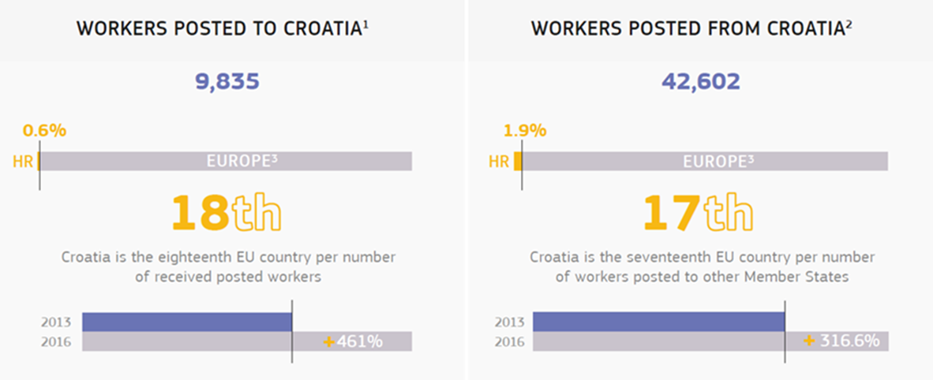
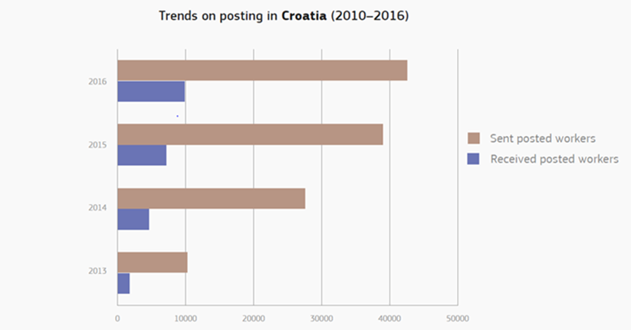
//Posting to and from Croatia

Slide 3
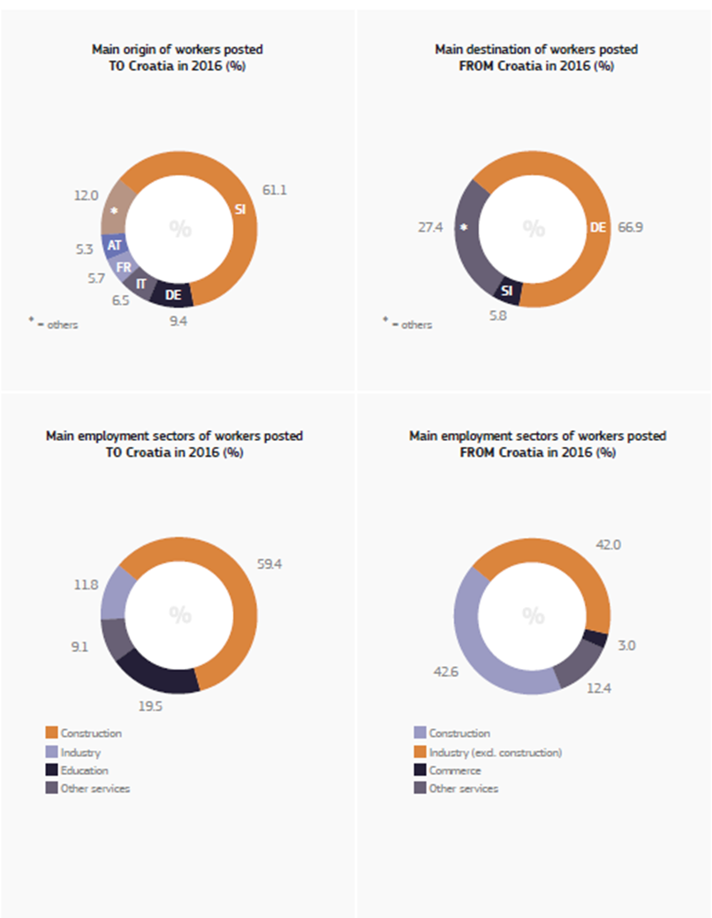
//Sectors

Slide 4
// Main findings
Problem of undocumented work was highlighted.
Language barrier was said to be of crucial importance, affecting the OSH of posted workers, mostly those coming to Croatia.
The temporality of posting affects OSH of posted workers.
Precariousness further affects OSH in the situation of posting.
Posting from Croatia resembles the historical connection of “gastarbeiters” that went from Yugoslavia to Germany (mostly from 1960 on), but is nowadays, within EU, performed under different legal circumstances and with different consequences when it comes to accidents.
The fellow workers in transnational workplaces in Germany are important for sharing OSH knowledge.

Slide 5
// Main findings
Trade unions and inspectorates stressed the importance of multi-sectoral and multi-level approach
The confusion over different kinds of migrant work (administrative categories) in the EU (among workers as well as in the public discourse) and the confusion over insufficient and incoherent information system was highlighted.
Trade unions were recognised as beneficial for helping workers resolve different OSH-related issues in posting situations.
Regarding preventive measures, our interlocutors pointed to lack of awareness raising informational materials which could prevent accidents at work .
Small enterprises (mostly from Slovenia) that send Croatian workers abroad are said to be the most problematic.

Slide 6
//Specific and illustrative cases
In the case of Croatia, posting still resembles the historical connection of “gastarbeiters” who went from Yugoslavia to Germany (mostly from 1960 on), but is nowadays, within EU, performed under different legal circumstances and with different consequences when it comes to accidents. The knowledge on new legal conditions and consequences in the case of accidents should be communicated more effectively, especially with workers.
Problem of undocumented work in the context of posting was highlighted; that rises a general questions: how to think undocumented work in relation to posting (in the case of Croatia this is related to: a) lack of documentation, such as work contracts and/or A1 forms, b) letterbox companies also created a special “undocumented situation” . . .

